Slide 1
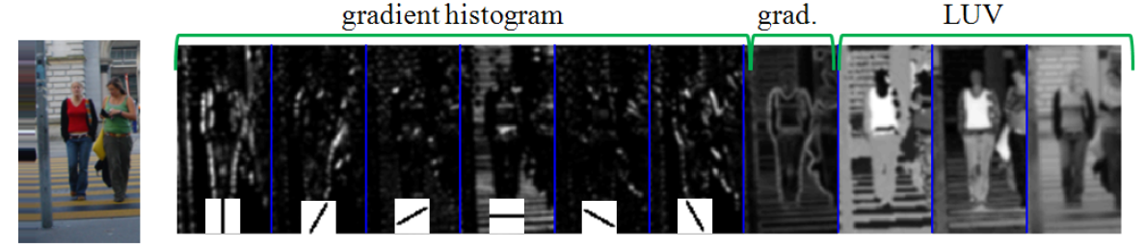
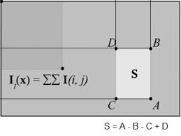
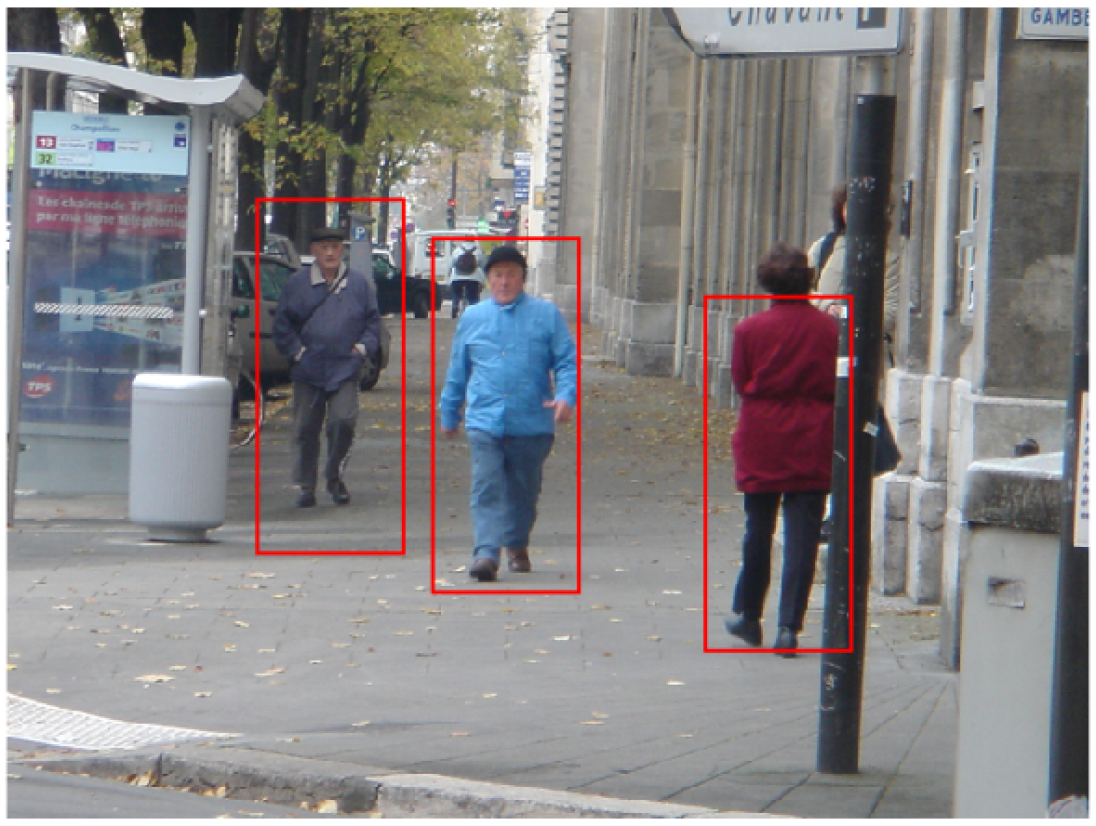
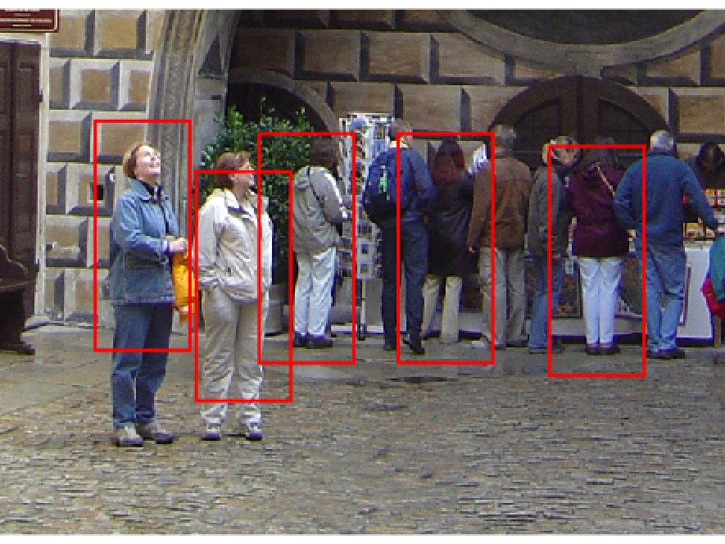
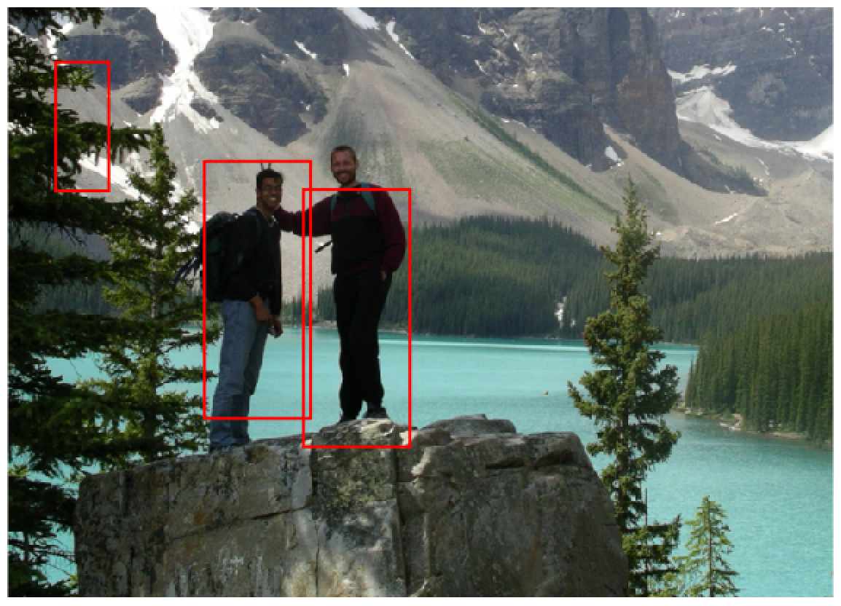
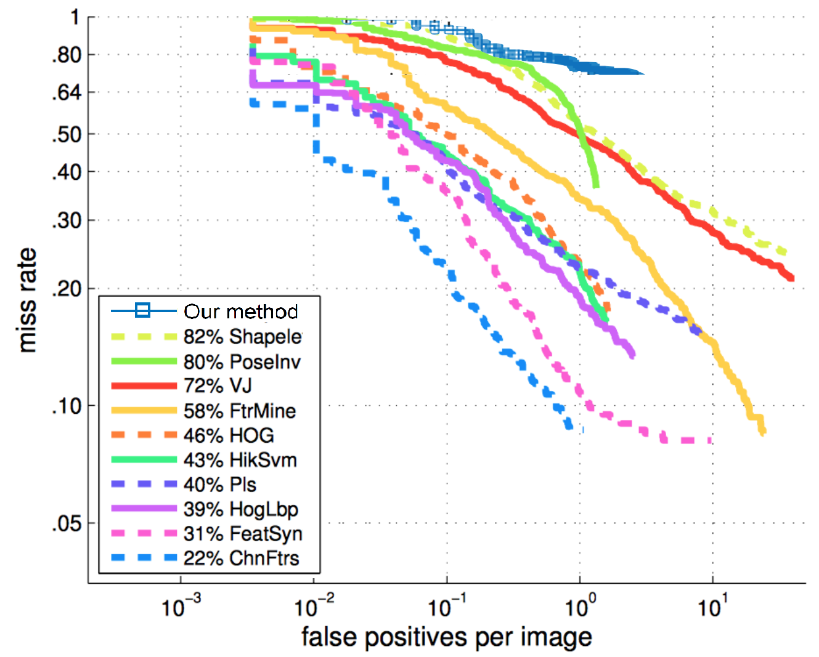
Pedestrian Detection Using Integral Channel Features
#006
Shiyuan Chen (shiyuanc), Taoran Dong (tdong)
Channels
Integral Image
Feature Selection
Training (INRIA)
Testing Results
AdaBoost
Cascade
AP: 0.2182
16s/image
Dollár, Piotr, et al. "Integral Channel Features." BMVC. Vol. 2. No. 3. 2009.

